Slide 1
Logic Design
Register Transfer Level

Slide 2
Register Transfer Level
Registers are assumed to be the basic components of the digital system.
The modules of a digital system are best defined by a set of registers and the operations that are performed on the binary information stored in them.
The information flow and processing performed on the data stored in the registers are referred to as register transfer operations .

Slide 3
Register Transfer Level
A digital system is represented at the register transfer level (RTL) when it is specified by the following three components:
  The set of registers in the system.
  The operations that are performed on the data stored in the registers.
  The control that supervises the sequence of operations in the system.

Slide 4
Register Transfer Level
The type of operations most often encountered in digital systems can be classified into four categories:
  Transfer operations, which transfer (i.e., copy) data from one register to another.
  Arithmetic operations, which perform arithmetic (e.g., multiplication) on data in registers.
  Logic operations, which perform bit manipulation (e.g., logical OR) of non numeric data in registers.
  Shift operations, which shift data between registers.

Slide 5
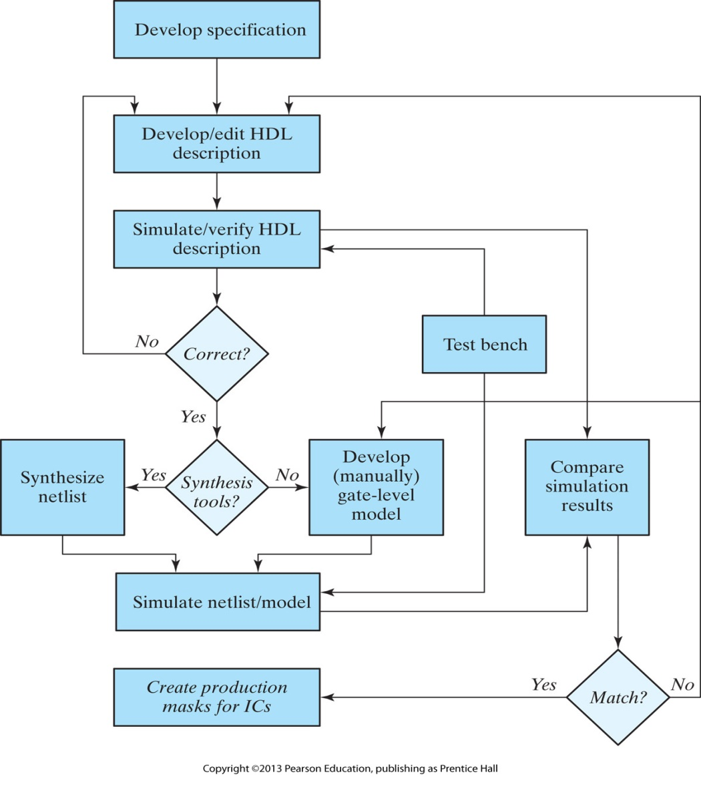
A simplified flowchart for HDL‐based modeling, verification, and synthesis

Slide 6
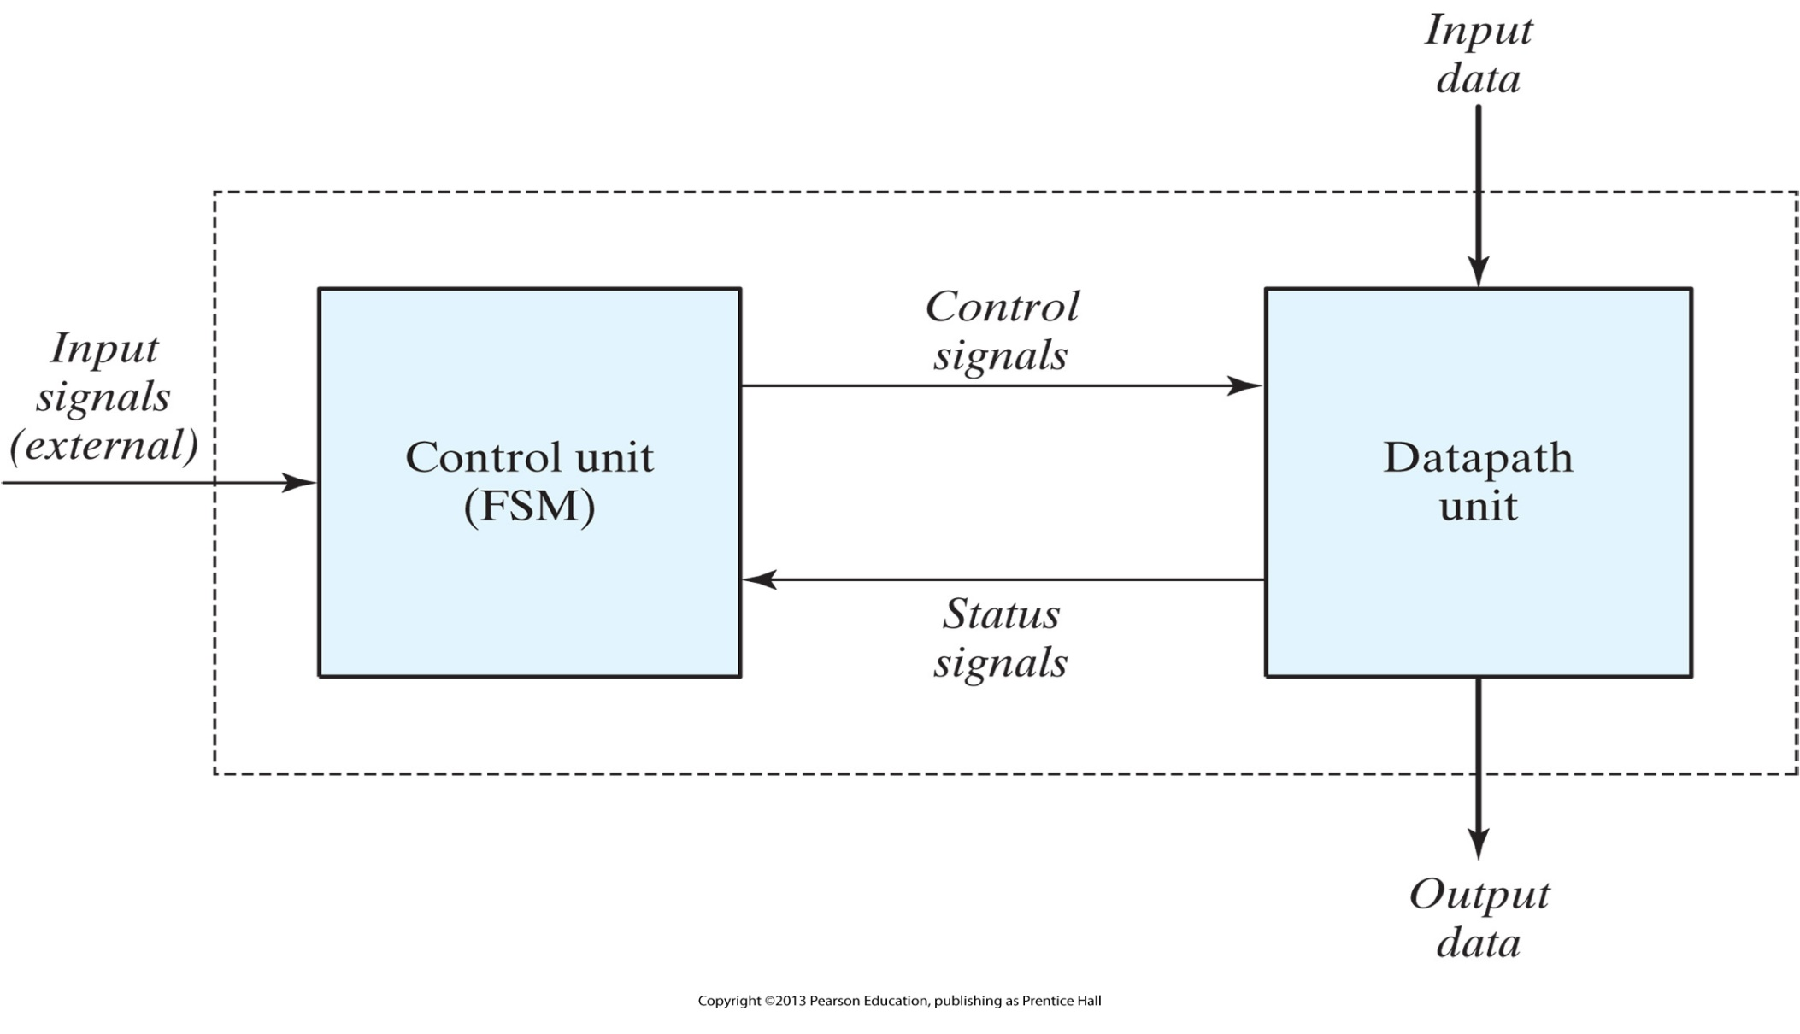
Control and datapath interaction

Slide 7
Algorithmic State Machines
An ASM chart resembles a conventional flowchart, but is interpreted somewhat differently.
A conventional flowchart describes the procedural steps and decision paths of an algorithm in a sequential manner, without taking into consideration their time relationship.
The ASM chart describes the sequence of events, i.e., the ordering of events in time, as well as the timing relationship between the states of a sequential controller and the events that occur while going from one state to the next (i.e., the events that are synchronous with changes in the state).
An ASM chart is composed of three basic elements: the state box, the decision box, and the conditional box.

Slide 8
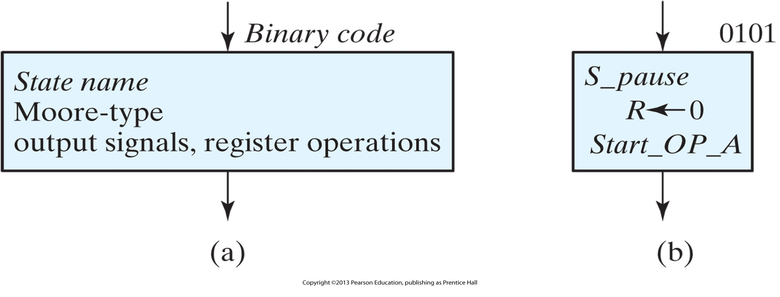
ASM chart state box

Slide 9
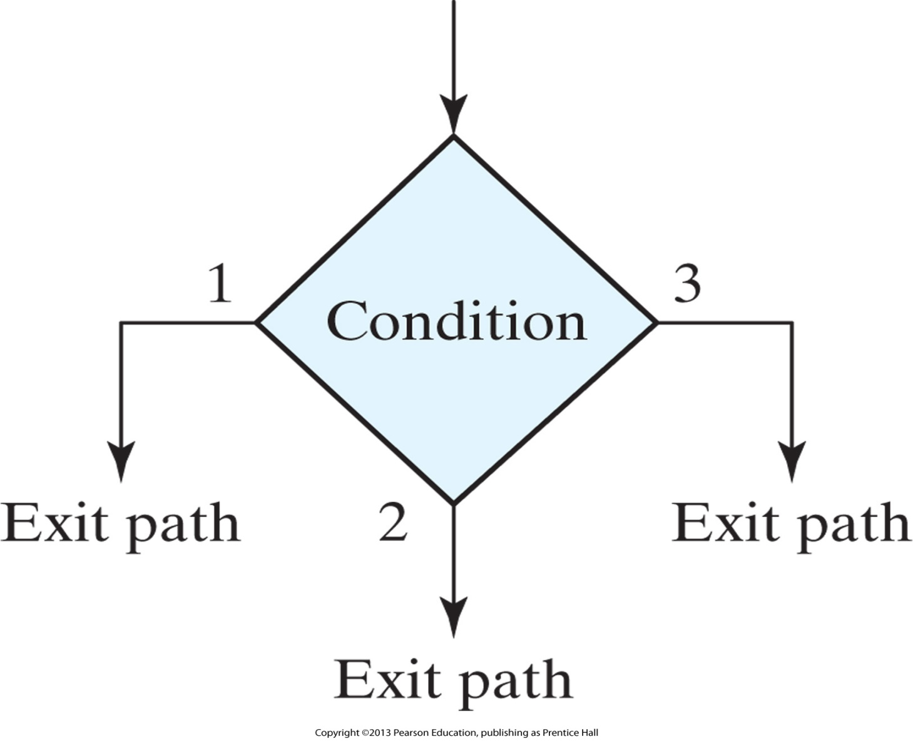
ASM chart decision box

Slide 10
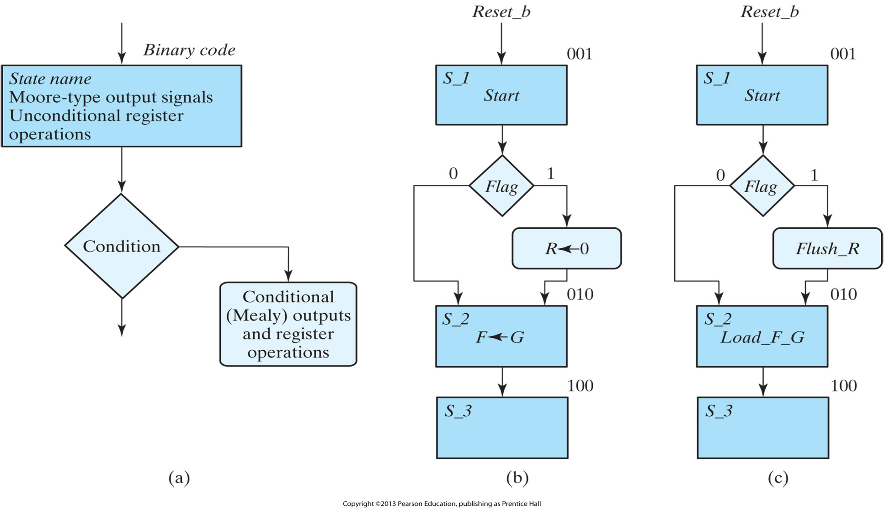
ASM chart conditional box and examples

Slide 11
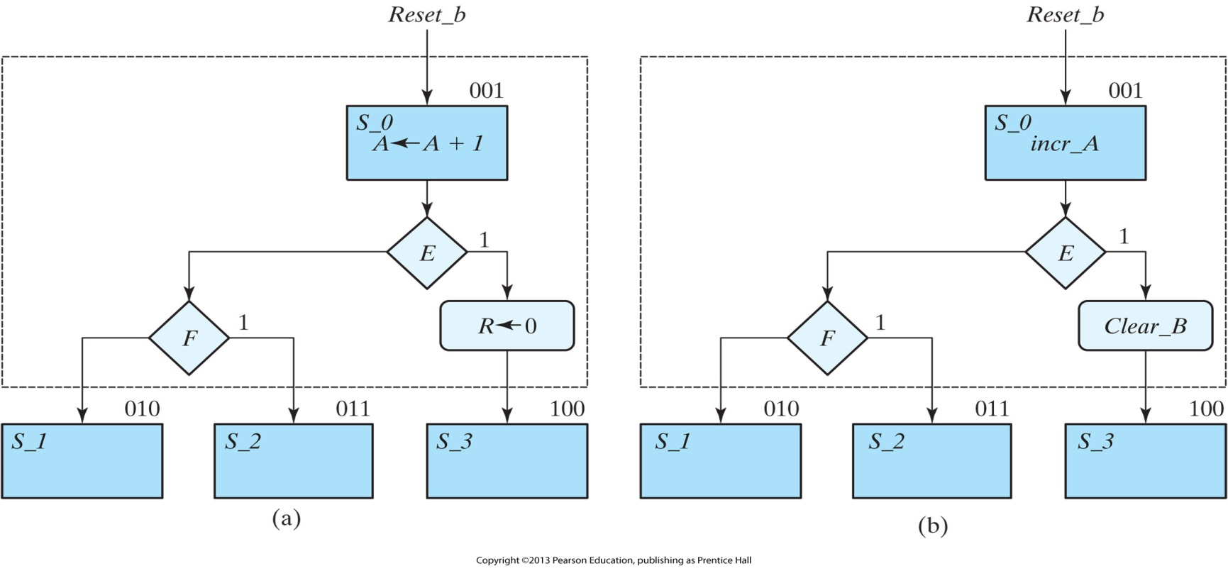
ASM blocks
An ASM block is a structure consisting of one state box and all the decision and conditional boxes connected to its exit path. An ASM block has one entrance and any number of exit paths represented by the structure of the decision boxes. An ASM chart consists of one or more interconnected blocks.

Slide 12
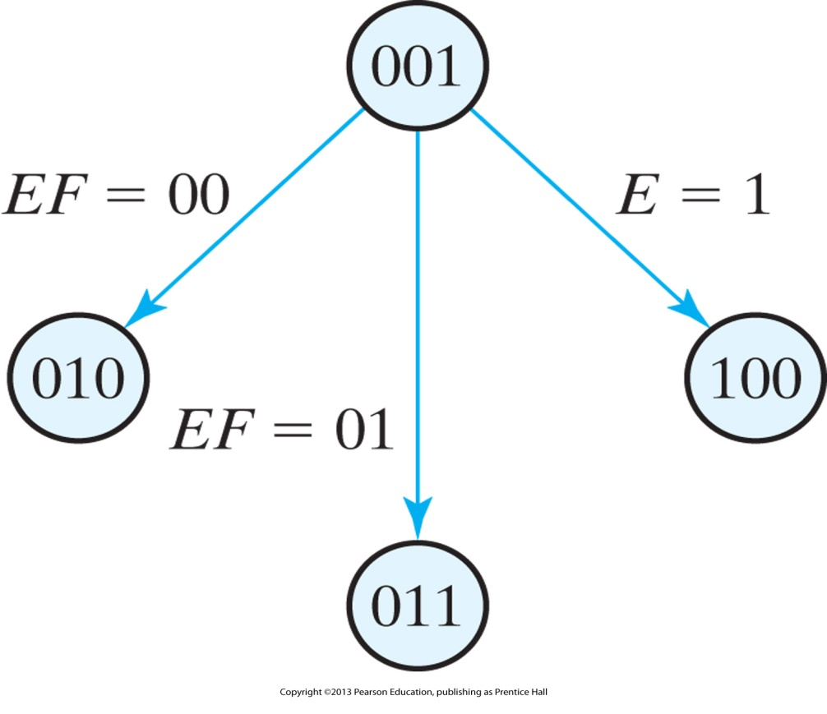
State diagram equivalent to the ASM chart of previous slide
The ASM chart is similar to a state transition diagram. Each state block is equivalent to a state in a sequential circuit. The decision box is equivalent to the binary information written along the directed lines that connect two states in a state diagram.

Slide 13
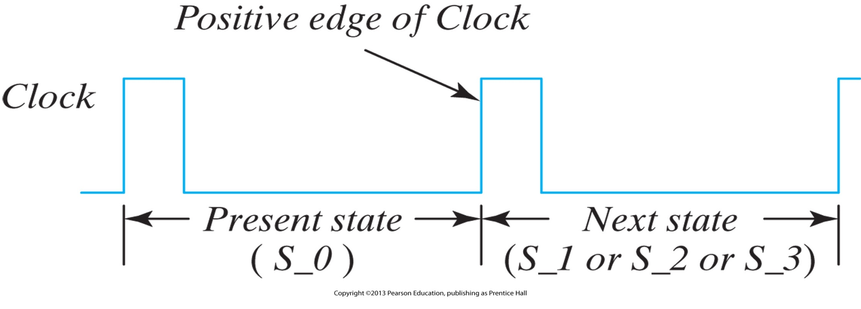
Timing Considerations: Transition between states

Slide 14
Algorithmic state machine and datapath charts
ASMD: clarify the information displayed by ASM charts and provide an effective tool for designing a control unit for a given datapath unit. An ASMD chart differs from an ASM chart in three important ways:
  An ASMD chart does not list register operations within a state box,
  The edges of an ASMD chart are annotated with register operations that are concurrent with the state transition indicated by the edge, and
  An ASMD chart includes conditional boxes identifying the signals which control the register operations that annotate the edges of the chart.
An ASMD chart associates register operations with state transitions rather than with states; it also associates register operations with the signals that cause them.
An ASMD chart represents a partition of a complex digital machine into its datapath and control units and clearly indicates the relationship between them. There is no room for confusion about the timing of register operations or about the signals that launch them.

Slide 15
ASMD
The steps to form an ASMD chart are:
  Form an ASM chart showing only the states of the controller and the input signals 2 that cause state transitions,
  Convert the ASM chart into an ASMD chart by annotating the edges of the ASM chart to indicate the concurrent register operations of the datapath unit (i.e., register operations that are concurrent with a state transition), and
  Modify the ASMD chart to identify the control signals that are generated by the controller and that cause the indicated operations in the datapath unit.

Slide 16
ASMD Design Example
Datapath unit to consist of two JK flip‐flops E and F, and one four‐bit binary counter A[3: 0] .
The individual flip‐flops in A are denoted by A3 , A2 , A1 , and A0 , with A3 holding the most significant bit of the count.
A signal, Start, initiates the system’s operation by clearing the counter A and flip‐flop F .
At each subsequent clock pulse, the counter is incremented by 1 until the operations stop.
Counter bits A2 and A3 determine the sequence of operations:
  If A2 = 0 , E is cleared to 0 and the count continues.
  If A2 = 1 , E is set to 1; then,
    if A3 = 0 , the count continues,
    but if A3 = 1 , F is set to 1 on the next clock pulse and the system stops counting.

Slide 17
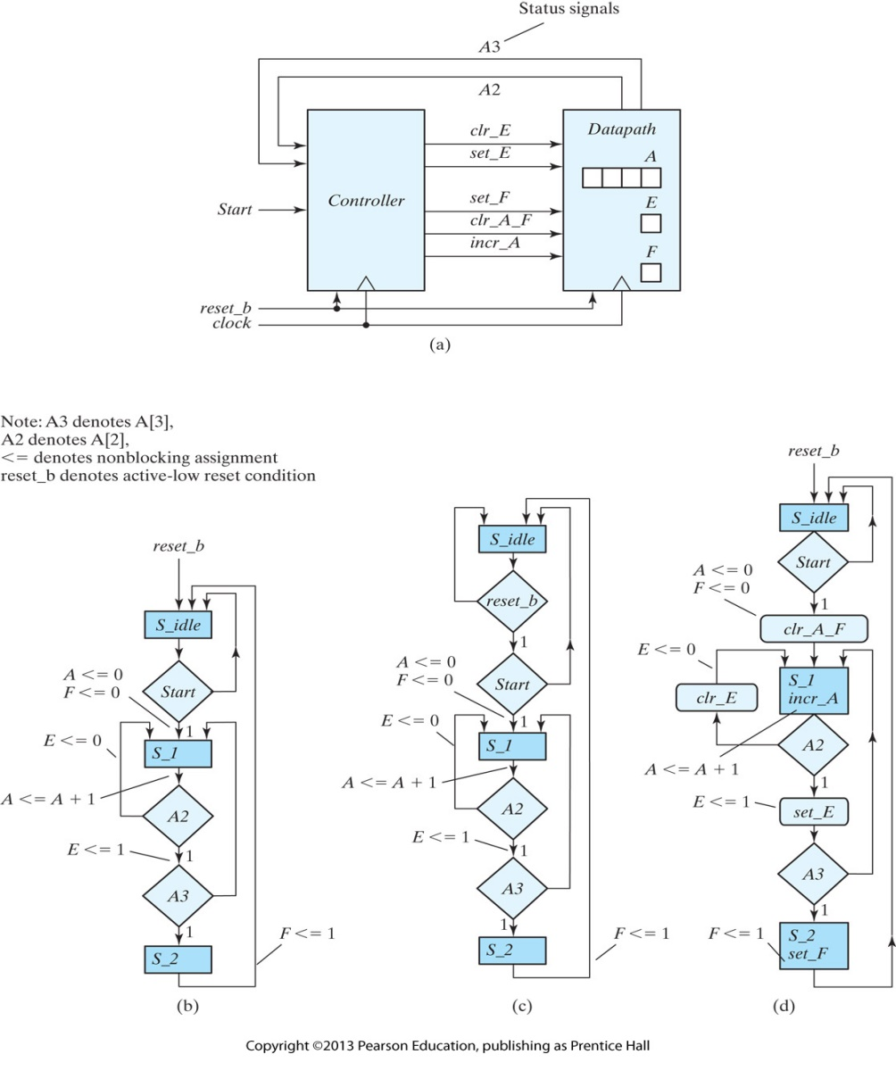
Block diagram for design example
ASMD chart for controller state transitions, asynchronous reset
ASMD chart for controller state transitions, synchronous reset
ASMD chart for a completely specified controller, asynchronous reset

Slide 18
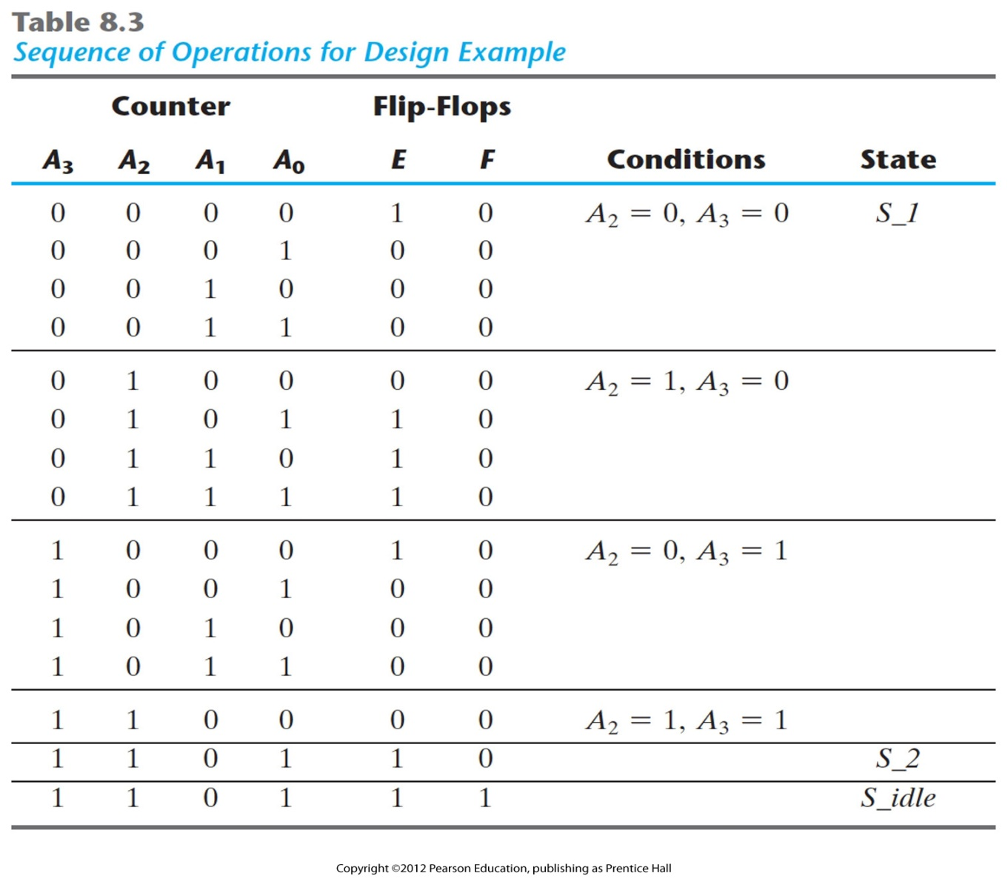
Sequence of Operations for Design Example

Slide 19
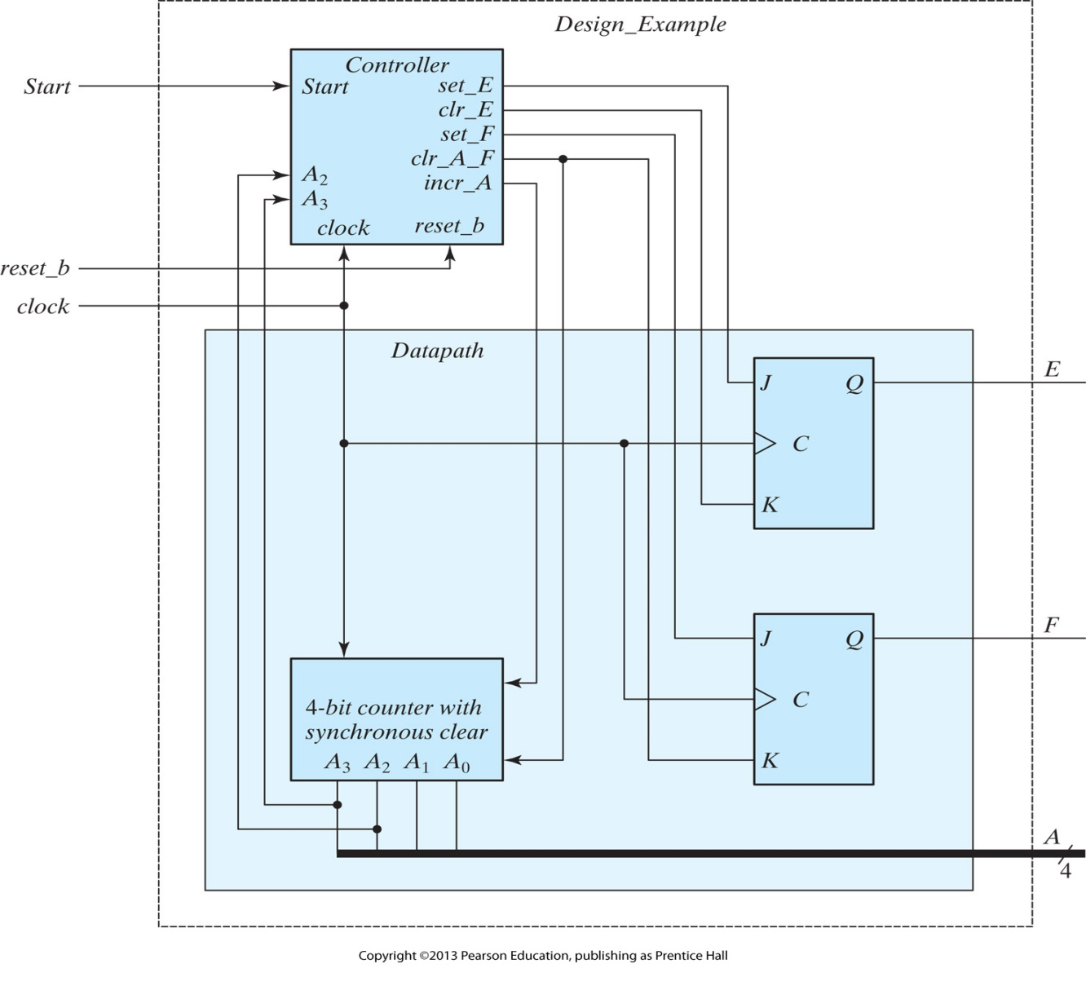
Datapath and controller for design example

Slide 20
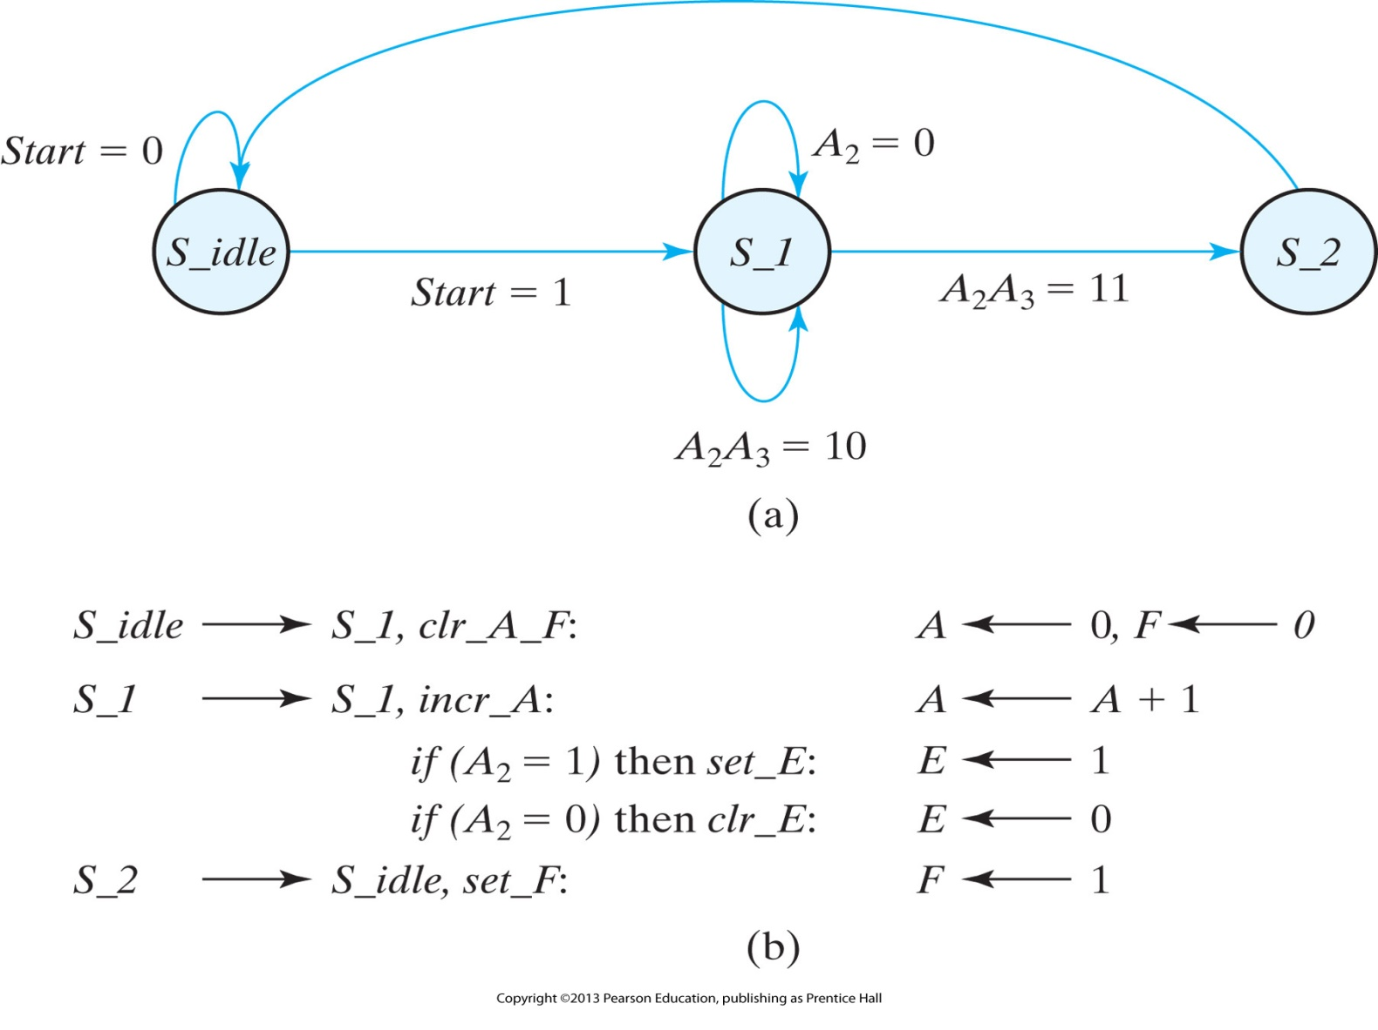
Register transfer‐level description of design example

Slide 21
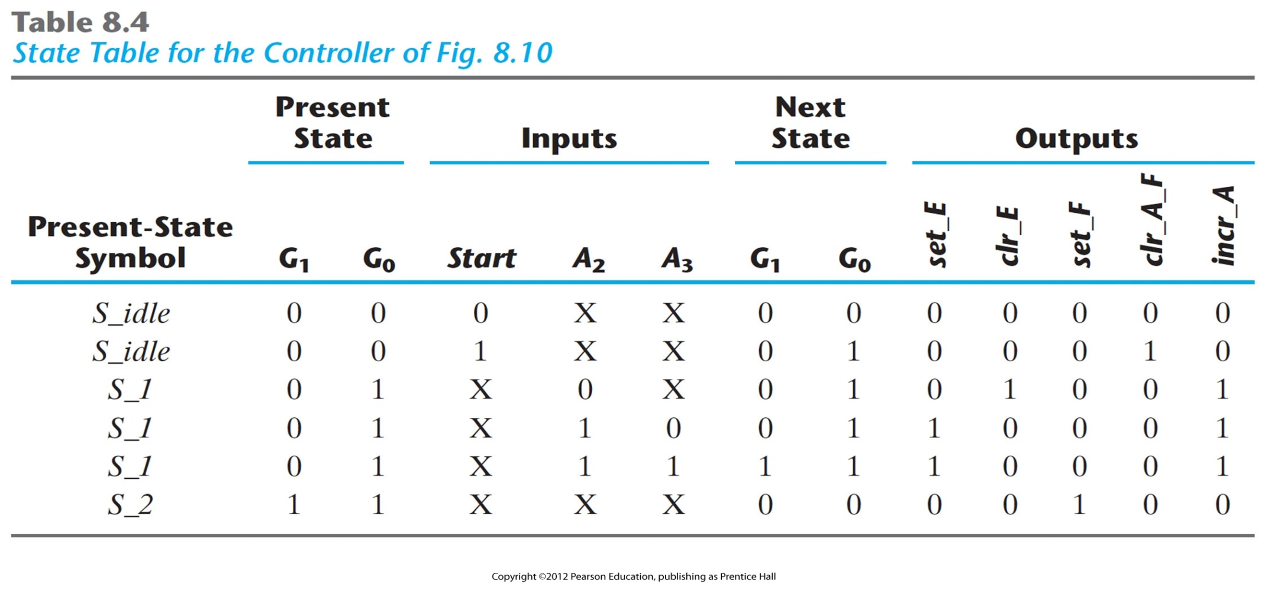
State Table for the Controller

Slide 22
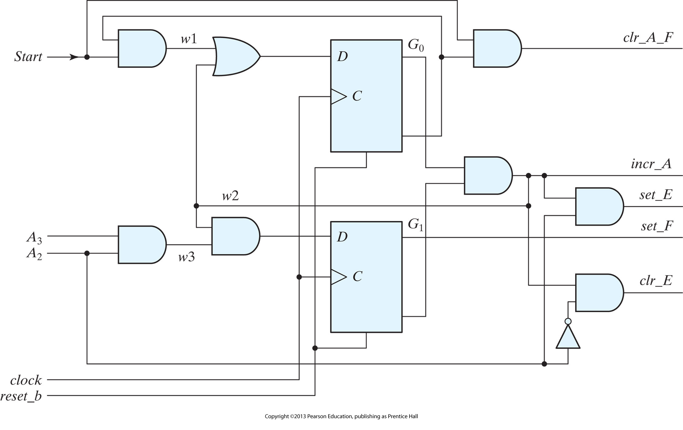
Logic diagram of the control unit

Slide 23
Design with Multiplexers
The register‐and‐decoder scheme for the design of a controller has three parts: the flip‐flops that hold the binary state value, the decoder that generates the control outputs, and the gates that determine the next‐state and output signals
However, a combinational circuit can be implemented with multiplexers instead of individual gates. Replacing the gates with multiplexers results in a regular pattern of three levels of components. These three components are predefined standard cells in many integrated circuits.
  The first level consists of multiplexers that determine the next state of the register.
  The second level contains a register that holds the present binary state. The third level has a decoder that asserts a unique output line for each control state.

Slide 24
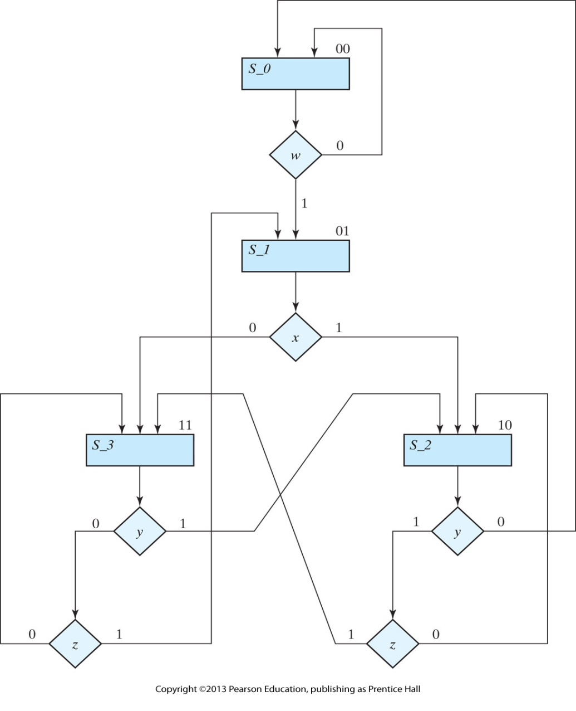
Example of ASM chart with 4 control inputs
Four states and four control inputs.
We are interested in only the control signals governing the state sequence. These signals are independent of the register operations of the datapath, so the edges of the graph are not annotated with datapath register operations, and the graph does not identify the output signals of the controller.
The binary assignment for each state is indicated at the upper right corner of the state boxes.
The decision boxes specify the state transitions as a function of the four control inputs: w, x, y, and z

Slide 25
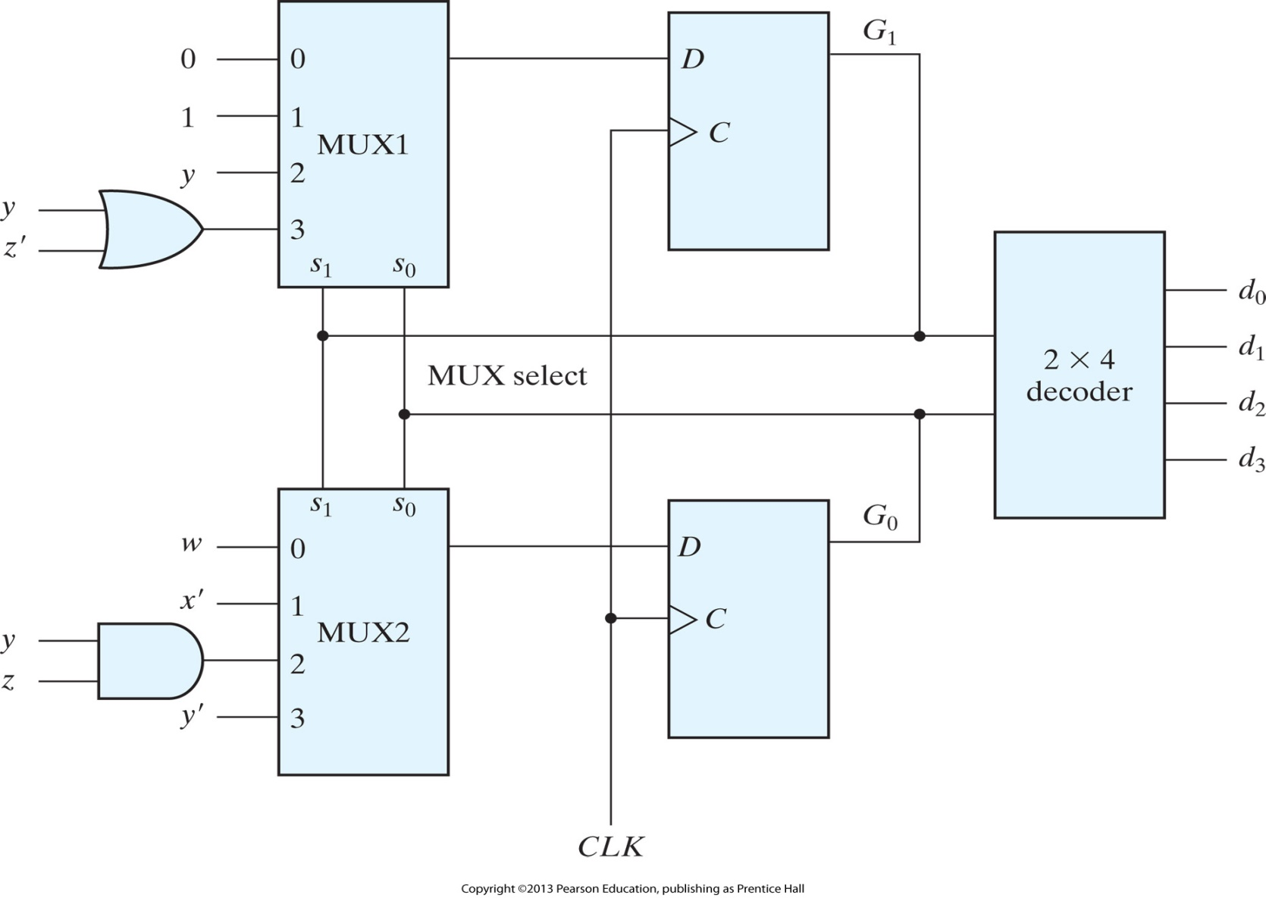
Control implementation with multiplexers

Slide 26
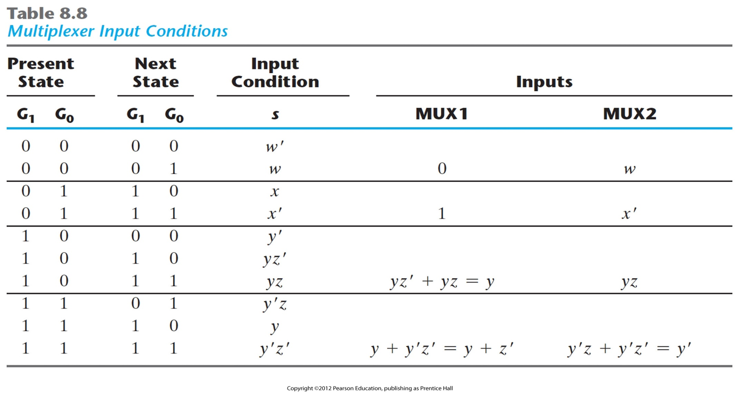
Multiplexer Input Conditions

Slide 27
Design with Multiplexers: Example
Design a system that counts the number of 1’s in a word of data.
Counter consists of two registers R1 and R2, and a flip‐flop E .
The system counts the number of 1’s in the number loaded into register R1 and sets register R2 to that number.
  For example, if the binary number loaded into R1 is 10111001, the circuit counts the five 1’s in R1 and sets register R 2 to the binary count 101.
  This is done by shifting each bit from register R1 one at a time into flip‐flop E .
  The value in E is checked by the control, and each time it is equal to 1, register R2 is incremented by 1.

Slide 28
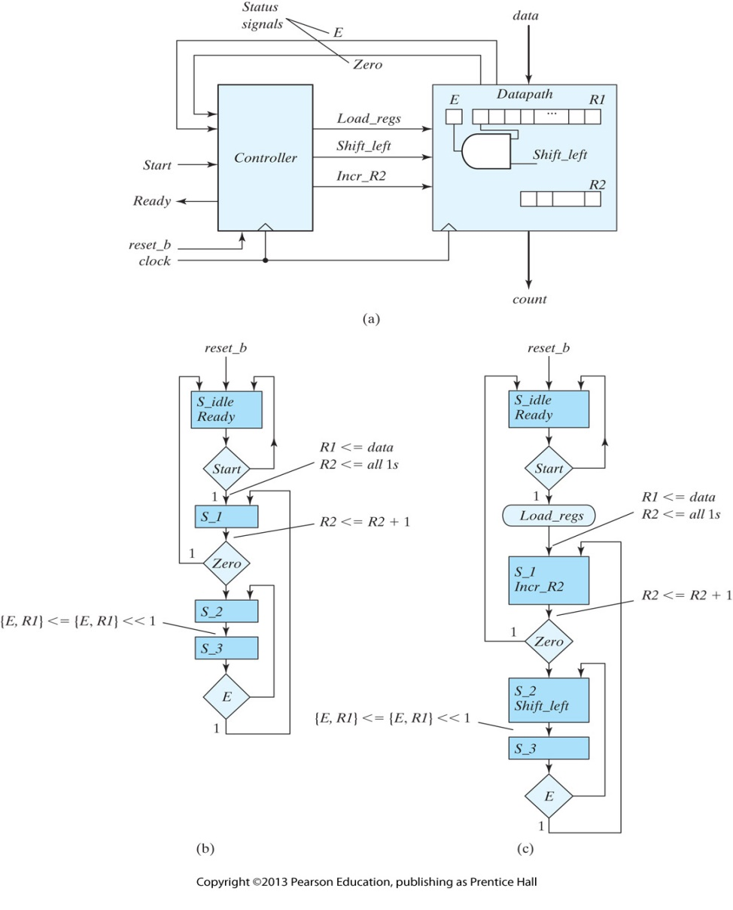
Block diagram and ASMD chart for count‐of‐ones circuit

Slide 29
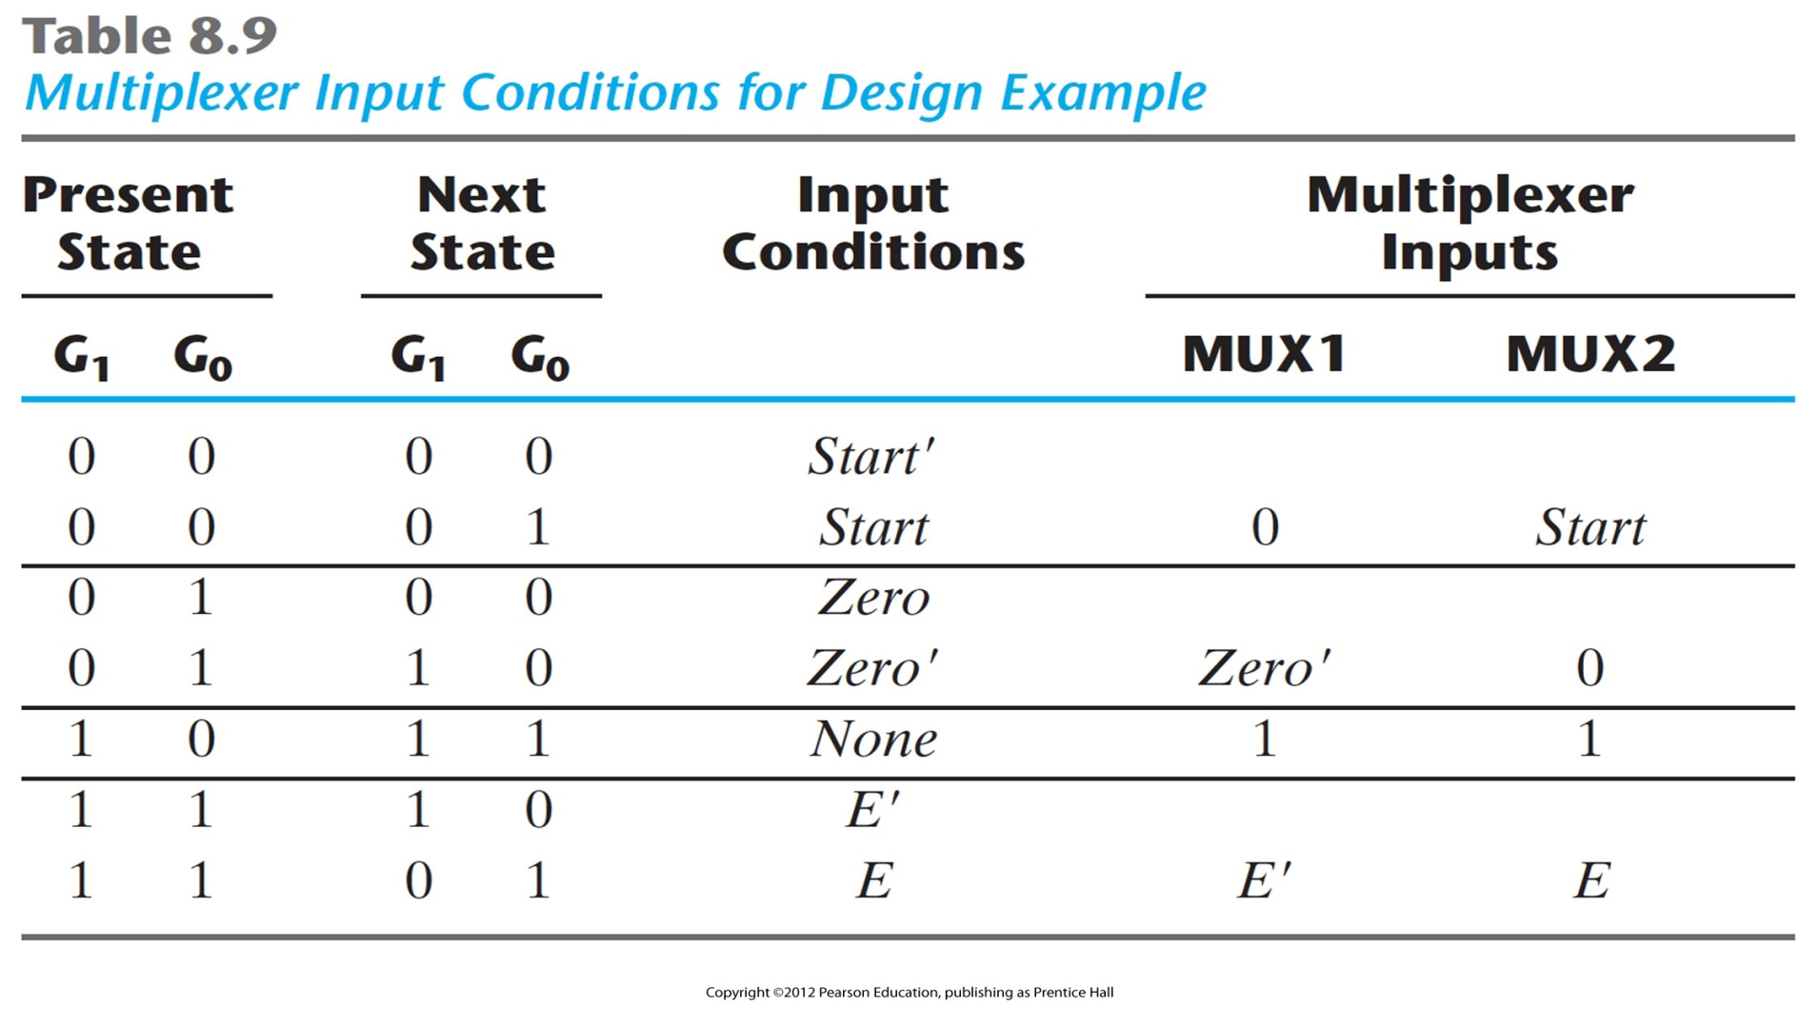
Multiplexer Input Conditions for Design Example

Slide 30
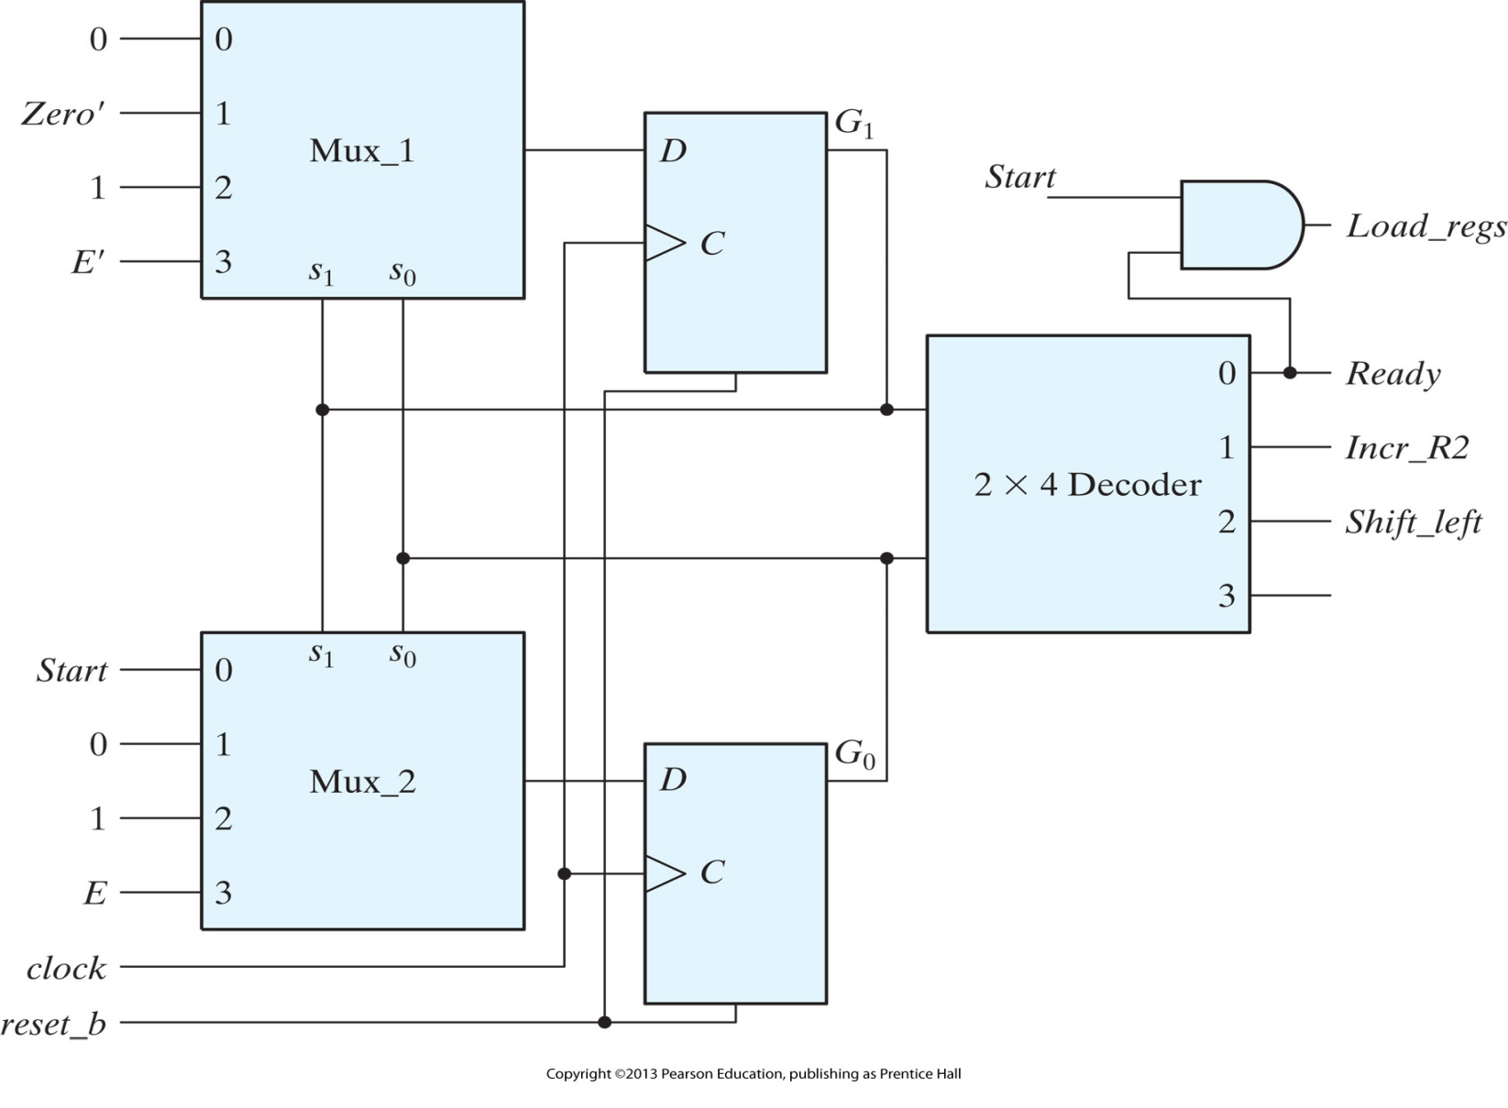
Control implementation for count‐of‐ones circuit

